Slide 1
BeagleBoard 101
Jason Kridner
jkridner@beagleboard.org
June 7, 2010
Archived at:
http://beagleboard.org/esc

Slide 2
Agenda
Overview
  Some BeagleBoard.org history
  BeagleBoard-xM features
  Classroom setup
  Validating the BeagleBoard-xM (hands-on)
Getting help from peer developers
  How to ask for help
  The BeagleBoard landscape
  Resources for more information and support
Play time (hands-on + Q&A)

Slide 3
What’s in a name…
Bring your own peripherals
Entry-level cost ($149/179)
ARM Cortex-A8 (superscalar)
Graphics and DSP accelerated
Linux and open source community
Environment for innovators
Notes:
3

Slide 4
Timeline
Feb 2008: Rev A concept demonstrated at meeting with key kernel maintainers and open source developers at TIDC
Jun 2008: Rev B launched broad availability with Digi-Key
Mar 2009: First hands-on ESC BYOES training
May 2009: Rev C doubles RAM to 256MB
Jan 2010: Rev C4 bumps performance to 720MHz and resolves USB power supply stability issue
Jun 2010: xM Rev A board demonstrated at hands-on ESC BYOES training

Slide 5

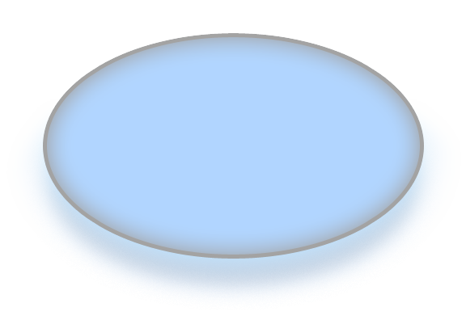
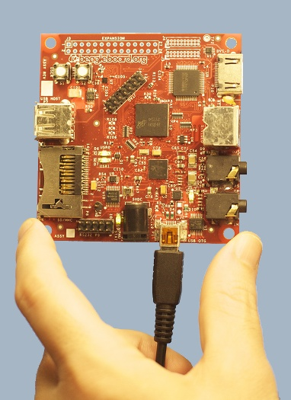
Community development
Wikis, blogs/RSS, promotion of community activity
$149
> 2,500 participants and growing
Personally affordable
Active & technical community
Freedom to innovate
Addressing
open source
community
needs
Android, Ubuntu, Angstrom, FFmpeg,MeeGo, Symbian, …
Open access to hardware documentation
Opportunity to tinker and learn
Free
software

Slide 6
Why such an active community?
$179 for same core processing
  used in more expensive, yet popular, commercial products
Focus on open source/hardware, DIY
  Tens-of-thousands of boards sold exclusively in small quantities
  All design, test, web, etc. materials shared
Embedded high-level OS training
  Ubuntu, Debian, Angstrom, Gentoo, WinCE, Symbian, QNX, and many others
The BeagleBoard community shares
  Over 150 registered projects on BeagleBoard.org
  Part of the Google Summer of Code with 6 on-going projects to improve Linux, XBMC, and other open source
  Average of around 5 articles or blog posts a day
  Over 2,500 English-language mailing list subscribers with additional dedicated mailing lists in Japanese and Portuguese and numerous project oriented mailing lists in dozens of languages
  Hundreds of followers on each of Facebook, Twitter, and LinkedIn
Rich ecosystem using the design materials
  Compatible or enhanced system-on-module/computer-on-module designs
    See http://beagleboard.org/resources
  Innovative mobile computers (TouchBook)
  Radios (BeagleBrick)
  Modular rapid prototyping development systems (Bug2.0)
  And many add-ons…
Affordable
Freedom to tinker at all levels
Lots of open starting points
Large and experienced community
Open ecosystem provides real options
6
Notes:
Community Participant
Really likes the interaction with other “open source people”
Tinkerer
Likes chemistry sets, making LEDs blink, and knowing how something works—working easily is less important
Underdog Fan
Likes to cheer on anyone who’ll take on the big corporate types, especially if it is against all odds
Cheap
Simply doesn’t want to pay for something that can be found for free or for low cost
Freedom Crusader
Has a fundamental belief that all IP should be shared for people to do what they want, as long as they give credit, share-alike, and otherwise “do no evil”

Slide 7
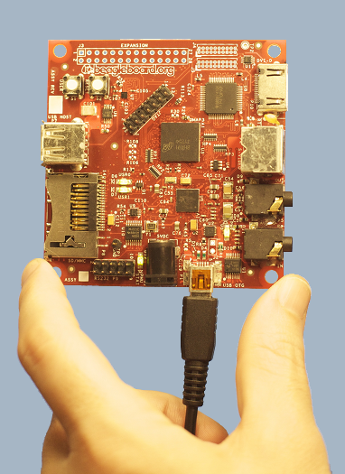

Fast, low power, flexible expansion
Peripheral I/O
DVI-D video out
SD/MMC+
S-Video out
USB 2.0 HS OTG
I²C, I²S, SPI,
MMC/SD
JTAG
Stereo in/out
Alternate power
RS-232 serial
OMAP3530 Processor
720MHz** Cortex-A8
  NEON+VFPv3
  16KB/16KB L1$
  256KB L2$
430MHz C64x+ DSP
  32K/32K L1$
  48K L1D
  32K L2
PowerVR SGX GPU
64K on-chip RAM
POP Memory
256MB* LPDDR RAM
256MB NAND flash
3.1”
* Revisions before C had 128MB
** Revisions before C4 were 600MHz
USB Powered
2W maximum consumption
  OMAP is small % of that
Many adapter options
  Car, wall, battery, solar, …

Slide 8
And more…
Collaboration at BeagleBoard.org
Live chat 24/7 via IRC
Links to project downloads
Other Features
4 LEDs
  USR0
  USR1
  PMU_STAT
  PWR
2 buttons
  USER
  RESET
  4 boot sources
  SD/MMC
  NAND flash
  USB
  Serial
3.1”
Peripheral I/O
DVI-D video out
SD/MMC+
S-Video out
USB HS on-the-go
I²C, I²S, SPI,
MMC/SD
JTAG
Stereo in/out
Alternate power
RS-232 serial

Slide 9
New for Revision C
3.1”
Peripheral I/O
USB HS/host-only
(in addition to existing
USB HS on-the-go)
LCD expansion
256MB LPDDR RAM
(up from 128MB)

Slide 10
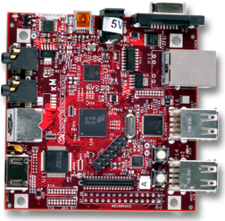
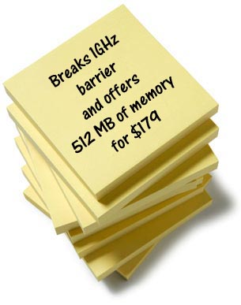
USB-powered BeagleBoard–xM unleashes community-oriented development
2,000 Dhrystone MIPS performance with ARM® Cortex™-A8
512MB POP memory enabling
  Native builds of Ubuntu and other distros
  More multitasking with complex apps like Firefox or OpenOffice.org
Robust expansion with more direct connectivity without external hubs; on-board Ethernet and five USB 2.0 ports
USB-powered board via low power processor integration
Active and growing open source community at beagleboard.org
xM means
Extra MHz
and
Extra MB
$179
10

Slide 11
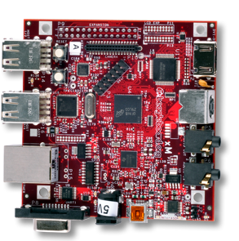

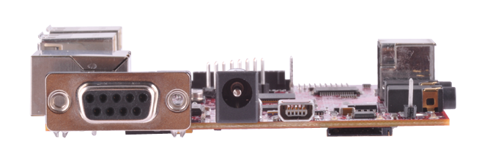
BeagleBoard-xM
Desktop-style USB peripherals and embedded style expansion
Laptop-like performance
3.25”**
DM3730 processor
(AM37x-compatibile)**
1GHz** superscaler ARM® Cortex ™-A8
More than 2,000** Dhrystone MIPS
Up to 20** Million polygons per sec graphics
512KB** L2$
HD video capable C64x+™ DSP core
POP Memory**
512MB** LPDDR RAM
LCD Expansion
I²C, I²S, SPI, SD Expansion
DVI-D
Camera Header**
S-Video
JTAG
USB 2.0 Hub**
  4-port
Stereo Out
Stereo In
10/100 Ethernet**
USB 2.0 HS OTG*
Alternate Power
RS-232 Serial*
microSD Slot*
DM3730
* Supports booting from this peripheral
** Change between Rev C4 and BeagleBoard-xM
Notes:
11

Slide 12
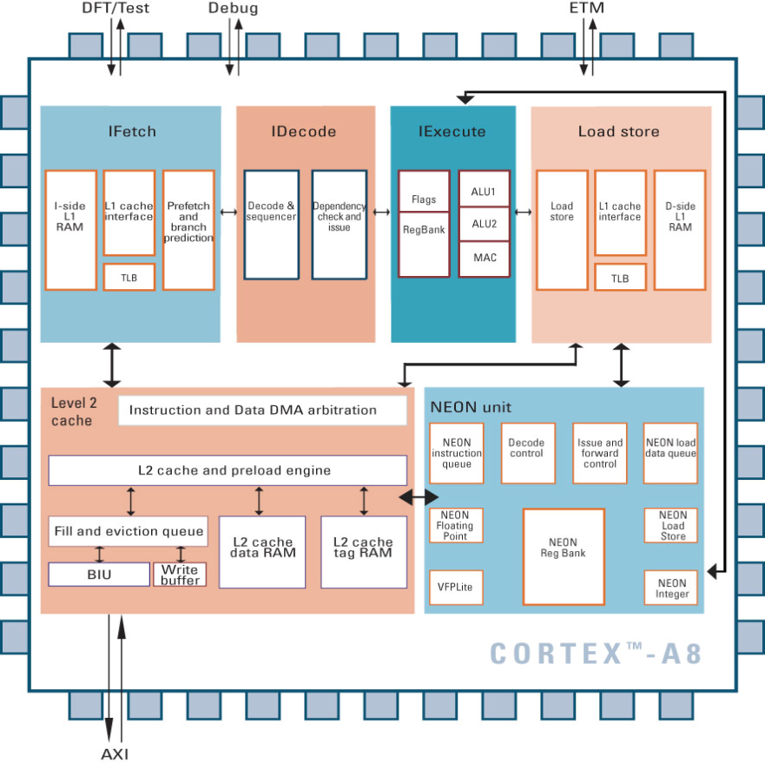
Cortex™-A8 : Block Level View
Dual issue In-Order Superscalar Pipeline
2.0 DMIPS/MHz
Support for ARMv7
Added new support for Thumb-2, Thumb-2EE(,Jazelle-RCT) and NEON
High speed Level 1 Caches (16KB)
Dual 32 entry memory translation TLB
Integrated NEON co-processor for media and signal processing
2 to 4x performance improvement
Integer and Floating Point support
VFPv3-IEEE754 compliant (single and double precision) floating point support.
Advanced Dynamic Branch Prediction
95% accurate across industry benchmarks
Integrated L2 Cache
256KB (low latency/high BW i/f w/L1)
Optimizes access to larger data sets and minimizes bus traffic
12

Slide 13


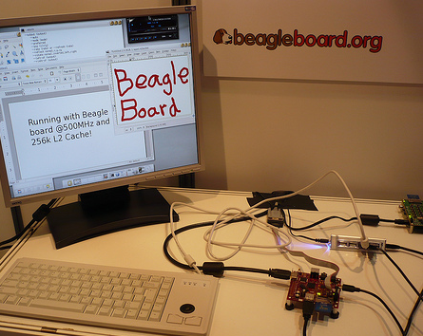

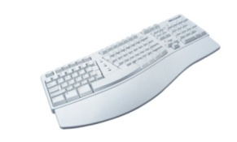

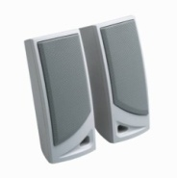
Use Beagle Board-xM like a desktop
SD
USB
Stereo in
Stereo out
Power
DVI-D
Note: Beagle Board can be powered from the alternate jack (as shown) or via USB
13
Notes:
13

Slide 14
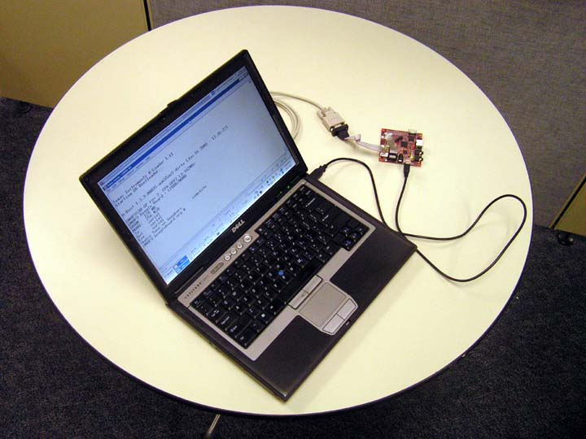
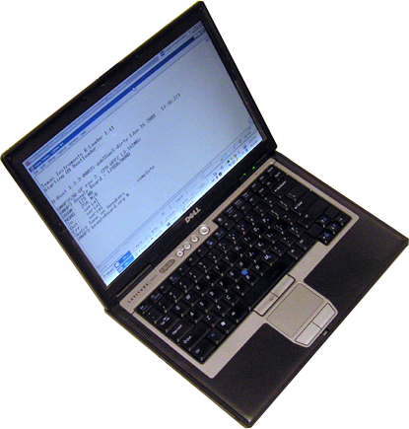
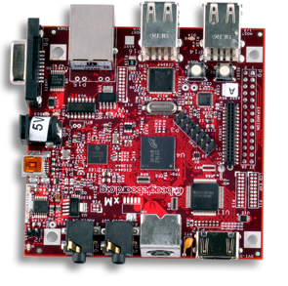
Take Beagle Board-xM anywhere & crank code on the go
Serial Port
Power
over USB
14
Notes:
14

Slide 15




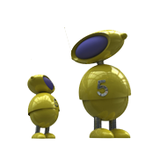
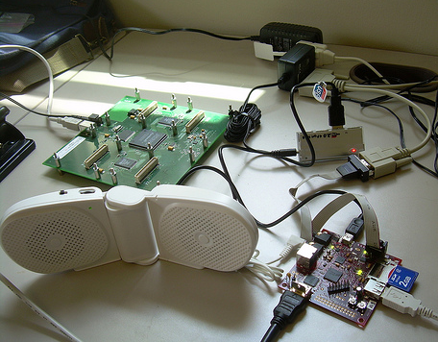
Expand your Beagle Board-xM
Turn innovations into mass-produced products to share with the world
USRP
USB
Power
SD
2GB
Stereo out
Photo by Philip Balister
15
Notes:
15

Slide 16
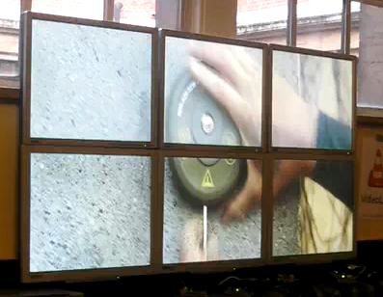
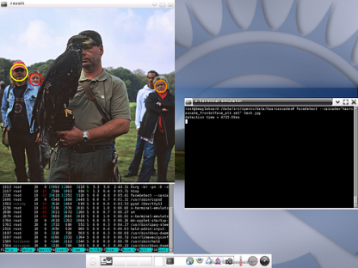
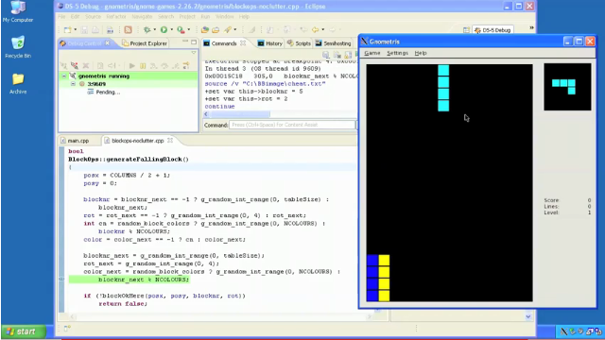
Open source, do-it-yourself, and pro developers embracing the BeagleBoard
FFmpeg BeagleBoard Video Wall
Over 150 registered projects on http://beagleboard.org/project and hundreds of development activities on-going…
Firefox
Ubuntu 10.04
Android
Gnome
Angstrom
Distribution
Gentoo
WinCE
QNX
Flash
TimeSys LinuxLink
MontaVista MVL6 and Montabello
RidgeRun SDK
ARM DS-5 and ALIP
Halcon machine vision
BeagleBoard video wall (>1080p video)
…
OpenCV
ARM DS-5 for the BeagleBoard
Notes:
Ångström Linux Distribution
Firefox 3.0, Epiphany-WebKit, etc.
AbiWord, GIMP, etc.
3D graphics and DSP codec integration
ARMv7+NEON gcc tool-chain
Maemo.org/Meego
FFmpeg
720P-24 MPEG4 decode on ARM+NEON only
AlwaysInnovating Touchbook
Beagle SDR (low-power software defined radio)
Windows Embedded for BeagleBoard
Handheld.org’s Mojo Ubuntu build for ARM
Android for Beagle
ARM Linux Internet Platform
Ubuntu, Debian, OpenOCD, Mamona, Ethernet, OKL4, robots, home automation, vision, e-ink displays, FreeBSD, QEMU, Fedora, …
Kernel, boot-loader, and boot utilities
Several more and growing…

Slide 17

Classroom setup
Notes:
17

Slide 18
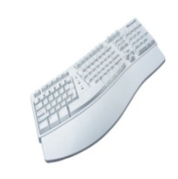


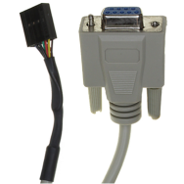
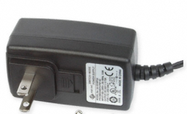

Equipment at ESC Chicago
For you to keep
  BeagleBoard xM Rev A
  microSD card
    Content for each class
  USB-to-serial adapter
  5V power adapter
For use in the labs
  DVI-D monitor and cable
  USB keyboard and mouse
DVI-D
Monitor
uSD
Desktop Computer Configuration

Slide 19
Boot-up
Connect everything besides power
Apply power
“Matrix” application starts in about 45 sec
  LED USR1 (D6) gives a “heartbeat”
  Click “Exit” on the lower right
    Exits to the GNOME desktop
To shut down: System → Shutdown

Slide 20
Verifying the BeagleBoard-xM hardware
Hands-on

Slide 21
Verifying the hardware
Code images, procedure, and sources are provided to verify the board functionality
  Links to the diagnostics found at http://BeagleBoard.org/support
  Includes bootloader, Linux kernel, and demo file system for testing
These sources act as examples for software developers
I'm still updating the /support site to include all the information for the xM.
Notes:
The first thing to do once you get BeagleBoard is to verify that the hardware is operating correctly.
Only basic software is provided on BeagleBoard, as most of the software is intended to be downloaded from or developed in conjunction with the technical community at BeagleBoard.org.
Find the links to the diagnostics code and step by step instructions for beagleboard at http://BeagleBoard.org/support
Many links to other software can be found via reference from BeagleBoard.org.

Slide 22
Get into the minimal ramdisk image
Apply power WITHOUT the USER button
  Applying power with the USER button pressed will result in the board not booting
Press and hold the USER button within 3 seconds until one of the LEDs starts to blink
  Timeout in u-boot.bin needs to occur, then USER button is sampled to load ‘user.scr’ rather than ‘boot.scr’
  MLO → u-boot.bin → user.scr → ramdisk.gz / uImage
Monitor should come to a login prompt
  Use ‘root’ and press <ENTER> for password
Expect updates to the ramdisk image to include some example scripts that got missed in building the current release image.

Slide 23
Access the SD from the RAMDISK
mkdir /proc
mkdir /sys
/etc/init.d/sysfs.sh
mkdir -p /media/mmcblk0p2
mount /dev/mmcblk0p2 /media/mmcblk0p2

Slide 24
Memory testmem
Boot minimal image
opkg install memtester
memtest 410M

Slide 25
LEDs testleds
export LED = “/sys/class/leds/beagleboard\:\:”
echo “none” > ${LED}usr0/trigger
echo “1” > ${LED}usr0/brightness
echo “0” > ${LED}usr0/brightness
echo “heartbeat” > ${LED}usr0/trigger

Slide 26
USER button testuserbtn
export GPIO = "/sys/class/gpio"
echo "4" > $GPIO/export
echo "in" > $GPIO/gpio4/direction
cat $GPIO/gpio4/value

Slide 27
Read events testhid
Kernel documentation: http://git.kernel.org/?p=linux/kernel/git/torvalds/linux-2.6.git;a=blob;f=Documentation/input/input.txt
opkg install evtest
evtest /dev/input/event0
  Press the “USER” button
  ^C to exit
evtest /dev/input/event4
  Move the mouse
  ^C to exit

Slide 28
Access monitor EDID
cd /sys/bus; ls; cd
cat /sys/bus/i2c/devices/3-0050/eeprom
i2cdump -y 0x3 0x50 b
decode-edid
fbset
This looks a bit different now and requires installation of the i2c-tools

Slide 29
USB OTG and EHCI
cd /sys/bus/usb/devices
ls
cat usb1/speed
cat usb1/1-2/1-2.2/manufacturer
cd
lsusb

Slide 30
Networking
Copy linux.inf from SD card to host and connect Beagle
ifconfig
nano /etc/networking/interfaces
ifdown usb0; ifup usb0
ifconfig
Configure your host using linux.inf
ping 192.168.123.1
VNC
  x11vnc &
  Connect with your VNC viewer from your host
Synergy
  Start Synergy server on your host
  synergyc --daemon --restart 192.168.123.1

Slide 31
Getting help from your peers
Understanding the basics of Linux

Slide 32
How to ask for help http://catb.org/~esr/faqs/smart-questions.html
Know the on-line resources
Know the on-line community
Know the manual
Listen to the answers
Pay for performance
Share the answers you find

Slide 33
Order of resources
  Search beagleboard.org, eLinux.org, the mailing list archive, and IRC logs
  Read and search BBSRM_latest.pdf
  Check the http://beagleboard.org/faq link
  Search the web
  Try something
    Gives you some perspective on what to ask
  Ask on IRC and be patient/polite
    Doesn’t disrupt everyone
  Mailing list
    Individual developers will go away if load isn’t shared

Slide 34
The community perspective
Earn respect by saying what you’ve done and how you’ve tried to find an answer
  Where did you search?
  What did you try on the board?
You aren’t entitled to an answer
  Show that you are willing to work for it and the community will feel you are a part of it
  Impatience implies that your time is more valuable than others in the community

Slide 35
Chat, mail, forums, blogs, and wikis!
All exist because they all solve different problems
Chat allows you to know someone’s listening
http://beagleboard.org/chat or #beagle on irc.freenode.net
  Great for beginner questions and rapid coordination
Mail allows you to reach almost anyone
http://groups.google.com/group/beagleboard
  Brings larger group into the conversation
  Provides you with a personal log in your inbox
Forums helps get the threads organized
https://community.ti.com/forums/32.aspx (minimal activity to avoid disrupting community critical mass)
Blogs provide emphasis, filtering, and timeliness
http://beagleboard.org/news and http://beagleboard.blogspot.com
Wikis enable inputs to become documentation
http://eLinux.org/BeagleBoard and http://code.google.com/p/beagleboard/wiki

Slide 36
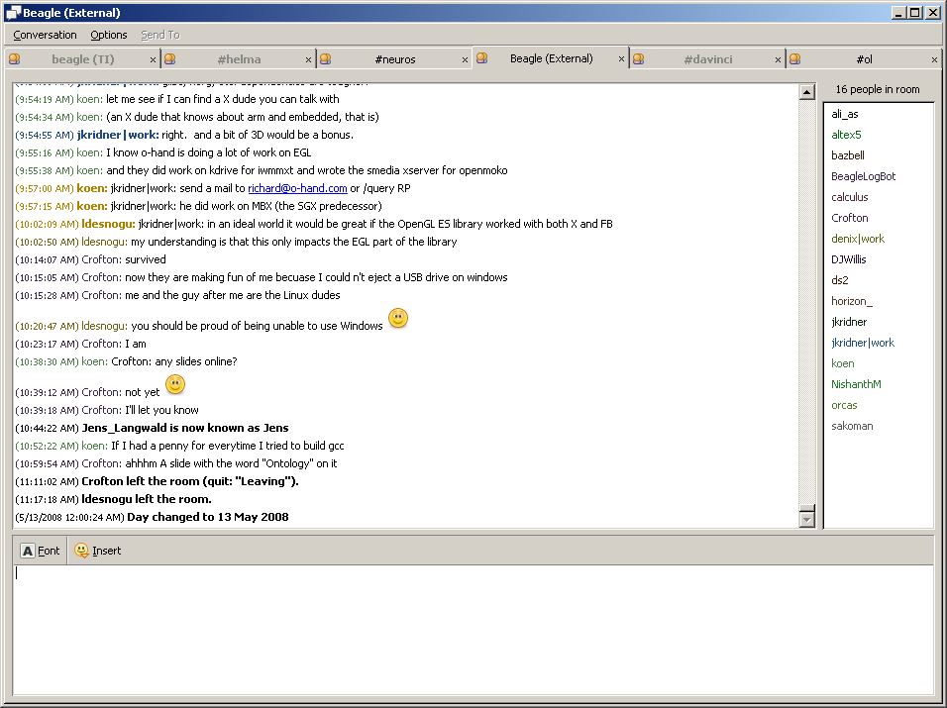
Chat on IRC
http://webchat.freenode.net
  #beagle: discussion of the BeagleBoard
  #gst-ti: discussion of GStreamer with TI DSP components
  #ubuntu-arm: discussion of Ubuntu on ARM processors
  #rowboat: discussion of Android on OMAP & Sitara devices
  #linux-omap: discussion of OMAP Linux kernel
  #davinci: discussion of TI DaVinci products
  #neuros: discussion of Neuros open source devices
IRC clients
  http://beagleboard.org/chat
  http://pidgin.im
  http://www.mirc.com
  http://en.wikipedia.org/wiki/List_of_IRC_clients
  http://www.ircreviews.org/clients

Slide 37
Angstrom and Open Embedded
Angstrom is what you are running
OE is a build tool
  Used by RidgeRun, Mentor Graphics, MontaVista, and many others
  Builds many distributions besides Angstrom
http://www.angstrom-distribution.org/

Slide 38
Ubuntu
Most popular Linux distribution
Has support for the BeagleBoard with a netbook installer
Builds all packages natively

Slide 39
Android
Uses (most) of the Linux kernel, but own versions of user-space applications
Runs applications within a virtual machine
At least half-a-dozen companies provide commercial support for Android on the BeagleBoard
Rowboat is the one endorsed by TI
0xdroid (0x1ab) and Embinux are also interesting and free

Slide 40
MeeGo
The combination of Moblin and Maemo
Maemo was the first of the two and started on OMAP processors
Good support on the BeagleBoard with demonstrations directly from the Linux Foundation
Initially focused on Internet Tablets and Netbooks
Very interesting for automotive infotainment

Slide 41
Gentoo
Builds every package from source
The Linux distribution the BeagleBoard.org web server runs
Builds ARM applications both natively and cross
This might be a useful source
  https://www.slashorg.net/48-Gentoo-port-for-BeagleBoard.html

Slide 42
QNX
Check out Foundry27
Has a free version to test out on the BeagleBoard
  http://beagleboard.org/project/QNX+Neutrino+on+OMAP/

Slide 43
Symbian
Initial open source release was on the BeagleBoard
  http://developer.symbian.org/wiki/index.php/BeagleBoard_Quick_Start
  http://beagleboard.org/project/symbian/

Slide 44
WinCE
Several commercial ports available from various providers
Possible to adapt TI’s EVM WinCE to BeagleBoard
  http://beagleboard.org/project/evmonbeagle/

Slide 45
Participating in the community
Joining the herd of cats
http://lwn.net/talks/elc2007
Building Community for your open source project
http://www.eclipsecon.org/2006/Sub.do?id=268
Video of Greg Kroah-Hartman on the Linux kernel
http://www.linuxelectrons.com/news/linux/16774/greg-kroah-hartman-linux-kernel
Sending kernel patches upstream
http://wiki.omap.com/index.php?title=Patch_upstream_sending

Slide 46
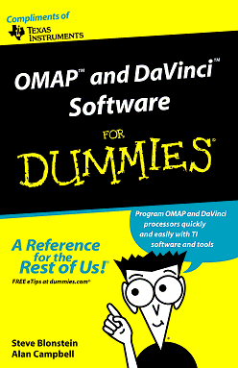
Baseline tools and software http://beagleboard.org/resources
Hardware verification procedure (http://beagleboard.org/support)
  GPL x-load, u-boot, Linux kernel, and demo distro for validation
  Code images, procedure, and sources are provided to verify the board functionality
GPL ARM GNU compiler collection (GCC)
  Code Sourcery version 2009q1 is the latest supported by TI
    Runs on Linux/Windows and generates ARMv7/Thumb2
  Angstrom version is utilized in ESC training and demo image on xM
Access to C6000 with compilers and open source software
  Free TI C6000 compiler for non-commercial use
    x86-Linux hosted (ARM hosted version in evaluation)
  GPL GCC compiler in progress (http://linux-c6x.org)
  C6Run (DSPEasy) project to simplify development model
  BSD/GPL DSP/Link interface software
Free 3D graphics libraries (OpenGLES 2.0)
Free production audio/video codecs for the DSP
Notes:
46

Slide 47
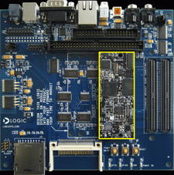
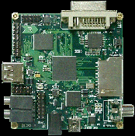
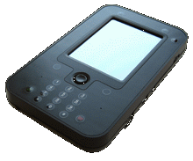
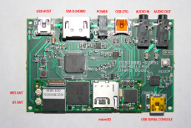
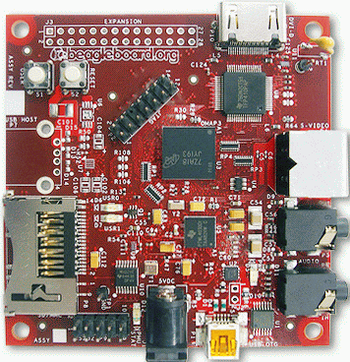
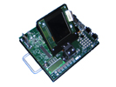
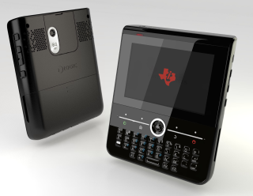
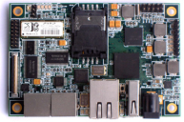
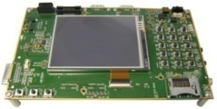
Some hardware options http://wiki.omap.com/index.php?title=OMAP3_Boards
TI/Mistral OMAP35x EVM
Nokia Internet Tablets
LogicPD OMAPZoom
Gumstix Overo
Analogue & Micro Cobra3530
Cogent CSB740
LogicPD OMAP35x Dev. Kit / Medical EVM
5.75” x 6.25”
Mini Board
3” x 3”
LogicPD OMAP34x Mobile Development Kit
3.8” x 6.3” x .95”
Gumstix Overo
Beagle Board
3” x 3”
OMAP35x EVM
4.25” x 7”
OMAP34x SDP
8.5” x 11”
Not to scale. Approximate size noted (in inches)

Slide 48






Many tools options http://focus.ti.com/dsp/docs/dspplatformscontenttp.tsp?sectionId=2&familyId=1525&tabId=2224
Many OS vendors are OMAP35x not listed here
Tool / Top features | Debug | Compile | Other
TI Code Composer Studio | Low-level ARM and DSP | Low-level ARM (ARMv7) and DSP (NEON roadmap) | Power-aware debug
ARM RealView | Low-level ARM | Application-level ARM (ARMv7, NEON)
Lauterbach | Low-level and app ARM and DSP | None | Extensive trace
Green Hills | Low-level and app ARM and DSP | Low-level ARM | Trace
CodeSourcery | Linux application debug | Linux kernel/app ARM (ARMv7, NEON)
Cortex-A8 uses ARMv7 instructions
Additional third party information: here

